Slide 1
Lecture 5. Types of chromosomes

Slide 2
Classification of chromosomes
Position of the centromere decides the shape of the chromosome
On the basis of number of centromere
Shape at Anaphase- V, J and rod shaped
Structure and Appearance- Linear/ Circular
Essentiality – A and B chromosomes
Role in sex determination - Allosomes and Autosomes (based on morphology and Number)
Function – special and normal chromosome

Slide 3
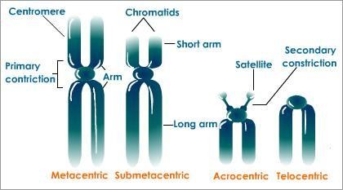
Classification of chromosomes
Position of the centromere decides the shape of the chromosome
Metacentric - two equal arms – V shaped
Submetacentric - sub median position –L shaped
Acrocentric- before end - J shaped
Telocentric - towards end – rod shaped

Slide 4
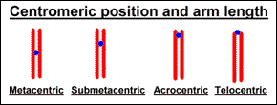

Slide 5
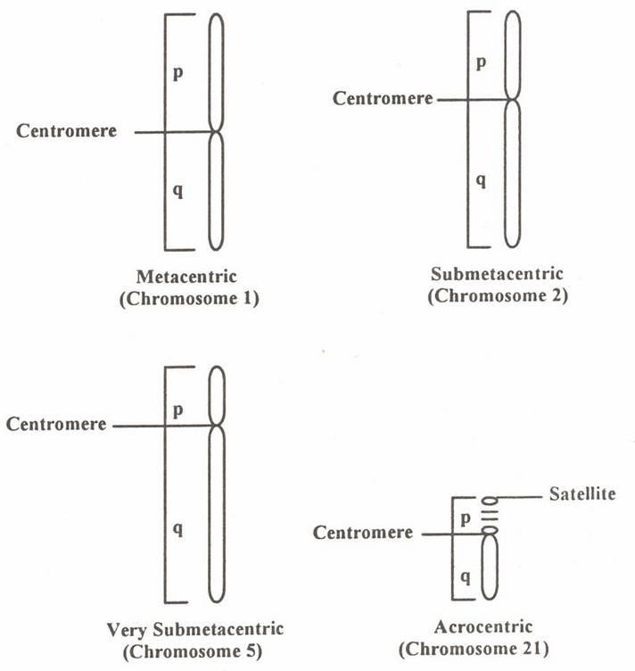

Slide 6
Classification of chromosomes
On the basis of number of centromere, it may be
Monocentric (one centromere - usual)
Dicentric (two centromere - wheat)
Polycentric (many centromeres - Ascaris)
Acentric (without centromere – do not survive)

Slide 7
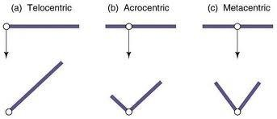
3. Types of chromosomes based on shape at Anaphase
Position of the centromere decides the shape of the chromosome
Metacentric - two equal arms – V shaped
Submetacentric - sub median position –L shaped
Acrocentric- before end - J shaped
Telocentric - towards end – rod shaped

Slide 8
4 .Types of chromosome - based on structure and function : Normal and Special chromosomes
Normal chromosomes:
Chromosomes with normal structure (shape and size) and function
Special chromosomes
Chromosomes which significantly differ in normal structure and function from normal chromosomes
Examples: Polytene and Lamp brush chromosomes

Slide 9
A. Polytene chromosomes
Also called as Giant chromosomes / Salivary gland chromosomes
First reported by Balbiani in 1881
The nuclei of the salivary gland cells of the larvae of Drosophila have unusually long and wide chromosomes, 100 or 200 times in size of the normal chromosomes.
The salivary gland cells do not divide after the glands are formed
But their chromosomes replicate several times (a process called endomitosis) and become exceptionally giant – sized to be called polytene chromosomes.

Slide 10
The polytene chromosomes of the salivary gland cells of
D. melanogaster contain 1000 to 2000 chromosomes, which are formed by nine or ten consecutive multiplication cycles and remain associated parallel to each other.
Further, the polytene chromosomes have alternating dark and light bands along their length.
The dark bands are comparable with the chromomeres of a simple chromosomes and are disc-shaped structures occupying the whole diameter of chromosome.

Slide 11
They contain euchromatin.
The light bands or inter bands are fibrillar and composed of heterochromatin.
The swollen regions are known as chromosome
“puffs” or Balbiani rings
They are the regions of genetic activity
Such puffs change location as development proceed, at specific locations.
The presence of a specific puff is related with the appearance of a specific protein

Slide 12
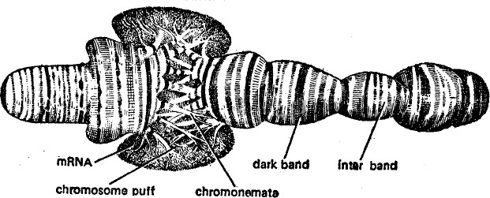

Slide 13
Significance of Puffs
They represent the site of DNA synthesis
– gene transcription
Transcription also occurs in the bands, but to a very small extent
The ribonucleoprotein is found accumulated in the region of puff

Slide 14
B. Lampbrush Chromosomes
In diplotene stage of meiosis, the yolk-rich oocyte of vertebrates contain the nuclei with many lampbrush-shaped chromosomes of exceptionally large size.
Lampbrush chromosomes discovered by Rucker in 1892
They have remarkable length
Sometimes larger than polytene chromosomes

Slide 15
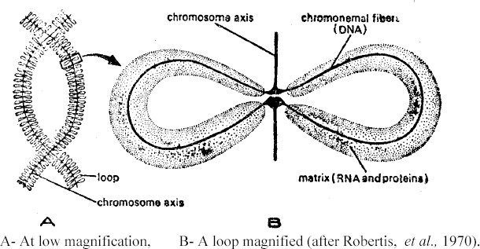

Slide 16
The large number of loops – projected in pair from the chromomere
One to nine loops may arise from a single chromomere
The chromomeres are connected by inter chromomere fibres
The chromosomal axis, the chromomere and the loop axis are all made up of DNA- genetically active

Slide 17
5.Types of chromosome - based on Role in sex determination: Autosomes and Allosomes
Autosomes:
These are the chromosomes that are found in all the body cells and they decide the somatic characters of the organism.
Chromosomes which do not differ in morphology and number in male and female sex
In humans, there are 46 chromosomes out of which 44 are autosomes and the remaining two are sex chromosomes.

Slide 18
Types of chromosome - based on Role in sex determination
Sex chromosomes( Allosomes):
These chromosomes are involved in the determination of sex of the organism.
In both animals and plants, these chromosomes are found different in both structure and functions.
In human males there are two sex chromosomes as XY and in human female there are two sex chromosomes as XX.

Slide 19
Allosomes
while in the male one allosome is identical to that of female and designated as X and the other differing morphologically and genetically is designated as Y.
The Y chromosome in most cases is smaller in size than the X chromosomes.
The Y chromosome in particular determines the male sex and hence it is described as androsome.
Apart from their role in sex determination, the allosomes also have a significant role in sex-linked inheritance.

Slide 20
6.Types of chromosomes based on
Essentiality – A and B chromosomes
A – chromosome :
Normal member of chromosome complement of a species which are essential for normal growth and development
B- Chromosome:Chromosome found in addition to normal chromosome

Slide 21
7.Types of chromosomes based on Structure and Appearance- Linear/ Circular
Linear chromosome: chromosome with linear structure or having both ends free. Such chromosomes are present in Eukaryotes.
Circular chromosome: chromosome with circular shape and structure, they found in prokaryotes

Slide 22
Other chromosomes
Other chromosomes
B Chromosomes
Ring Chromosomes
Isochromosomes

Slide 23
Unusual of Chromosomes
In certain animals and plants, one or more chromosomes are found different from the basic structure of the normal chromosomes and these chromosomes are abnormal in size and shape. These chromosomes are called unusual of chromosomes.
Some of the common examples of this type are
B-chromosomes and Double minutes.

Slide 24
Unusual of Chromosomes
The B-chromosomes have other names as accessory and supernumerary chromosomes.
They are common in plants and they reduce their viability.
These chromosomes are certain extra chromosomes that are found in certain individuals in a group like in case of maize.

Slide 25
Unusual of chromosoemes
The double minutes are present in the cancer cells which show resistence against the drugs that are intaken by the cancer patient.
These are chromosome like structures that are unstable.
These chromosomes have telomeres that are formal and do not have any centromere.

Slide 26
3. B-Chromosomes
Also called as accessory chromosome
Super numerary chromosome
It is an extra chromosomes not necessary for an individual
Usually acro or telocentric in nature
They do not pair with normal chromosomes during meiosis
Recorded by Longley and Randolph in Maize (1927)
Now reported in 42 families of Angiosperms including 163 genera and 475 species
Much smaller than normal chromosome

Slide 27
Classified in two different ways
On the basis of their stability
On the basis of their size
On the basis of their stability
Stable – mitotically stable and all cells will have the same number
Unstable - mitotically unstable and each cell will have different number of B chromosome within the same individual

Slide 28
On the basis of their size
Standard type – 1/4th length of normal chromosome, median centromere and uniform thickness
Small type – smaller size but not smaller than 1/2 of the standard B chromosomes
Very small type- small dot like structures, smaller than standard B chromosomes
Large type- chromosomes of double the size- large accessory chromosomes

Slide 29
The origin of the B-chromosomes is uncertain. In some animals they may be derivatives of sex chromosomes.

Slide 30
Meiotic behaviour of B chromosomes
They do not pair with A chromosomes
Low degree of pairing is observed in B chromosomes
Long B will pair with Long B and short B will pair with Short B
When single B chromosome is present, they remain univalent during Pachytene
When two B chromosomes are present they pair at pachytene

Slide 31
4. ISO Chromosomes
An isochromosome is a chromosome in which both arms are identical.
Both the arms are similar in morphology and gene content
Originate by misdivision of centromere (vertical or transverse manner
It is thought to arise when a centromere divides in the wrong plane, yielding two daughter chromosomes, each of which carries the information of one arm only but present twice.

Slide 32
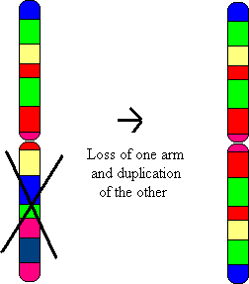
An isochromosome is a chromosome that has lost one of its arms and replaced it with an exact copy of the other arm

Slide 33
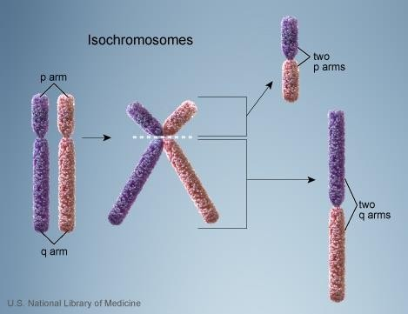

Slide 34
The isochromosomes are formed during mitosis and meiosis.
If a gamete having a isochromosome is fertilized by a normal gamete, the zygote will possess an unbalanced karyotype.
In Drosophila, the misdivision of centromere of telocentric X chromosome changes that into an “attached-X” isochromosome,
In man X- isochromosome causes the disease called gonadal dysgenesis.

Slide 35
Ring chromosomes
A ring chromosome is a chromosome whose arms have fused together to form a ring.
A ring chromosome is denoted by the symbol r.
Ring chromosomes may form in cells following genetic damage by mutagens like radiation, they may also arise spontaneously during development.
Ring chromosomes found in prokaryotes

Slide 36
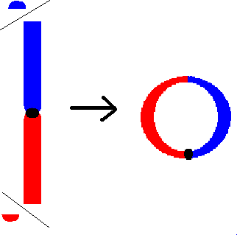
Formation of ring
Normally, the ends of a chromosome are lost, enabling the arms to fuse together. However, ring formation can also occur with only one end being lost.
In rare cases, the telomeres at the ends of a chromosome fuse without any disappearing of material
Dr.DD

Slide 37
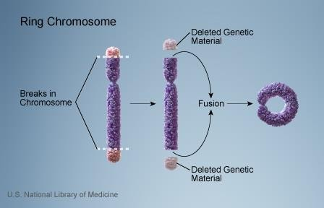
Dr.DD

